Slide 1


String Class and Methods
KVS CHARAN(T1735)
A Quest Global Company

Slide 2
Using method from one class to another
In object-oriented programming, calling a function from one class to another typically involves creating an instance (object) of the second class inside the first class. This allows the first class to call methods or functions from the second class.
In Java, calling a method from one class to another is similar to what we do in other object-oriented languages. The key is to create an object (instance) of the class whose method you want to call and then invoke the method on that object.
Creating an Object: In both examples, an object of Class A is created inside Class B using new A().
Calling the Method: The method from Class A is invoked using the object, for example, classA.show() or classA.add().
Access Modifiers: Make sure that the methods you're trying to call have appropriate access modifiers (public, protected, or private) to ensure visibility from another class. In the examples above, the methods are marked as public so they can be accessed from other classes.

Slide 3
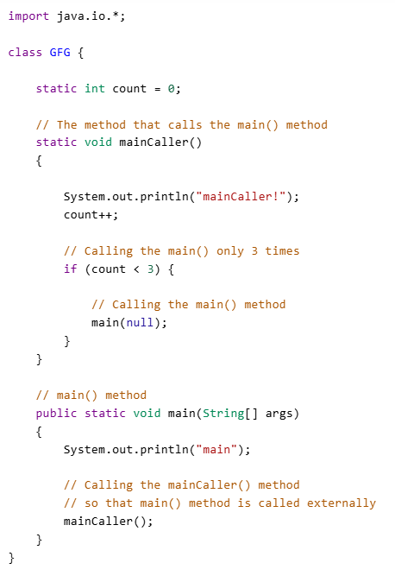
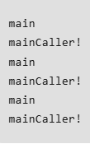
Code
Output

Slide 4
String
In Java, String is the type of objects that can store the sequence of characters enclosed by double quotes and every character is stored in 16 bits i.e using UTF 16-bit encoding. A string acts the same as an array of characters. Java provides a robust and flexible API for handling strings, allowing for various operations such as concatenation, comparison, and manipulation.
String Comparision:In Java, string comparison is a common task that you can accomplish in several ways depending on the type of comparison you need to perform. Using operators

Slide 5
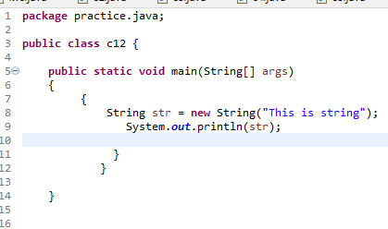
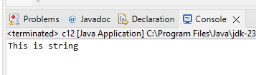
Output
Code

Slide 6
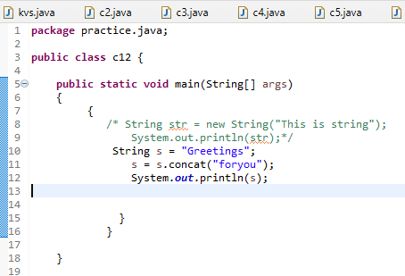

String Methods
String Concatenation
The string concat() method concatenates (appends) a string to the end of another string. It returns the combined string. It is used for string concatenation in Java. It returns NullPointerException if any one of the strings is Null.
We can use symbol ‘+’ also concat() to do the concatenation.
Code
Output
Greetingsforyou

Slide 7
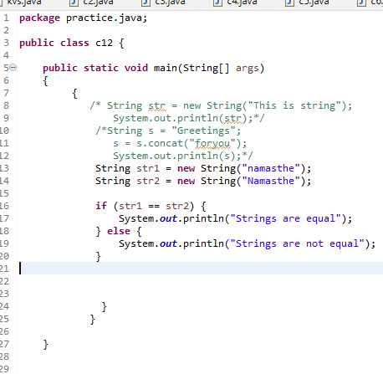

String Comparision
In Java, there are different ways to compare strings. Since strings in Java are objects, you need to use specific methods for comparison rather than the == operator. The methods to compare strings depend on what aspect of the string you're trying to compare—whether it's checking for equality or ordering.
Code
Output

Slide 8
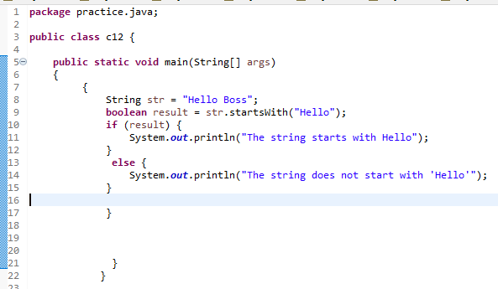

String Start
In Java, the term "string start" typically refers to checking whether a string begins with a specific prefix. This can be achieved using the startsWith() method.
boolean startsWith(String prefix) is syntax.
Code
Output

Slide 9

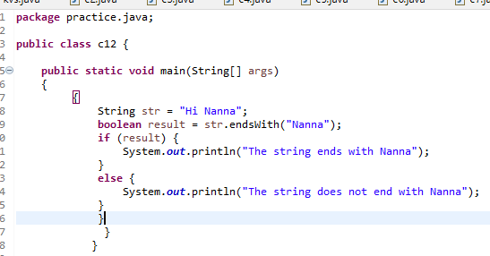
String End
In Java, the term "string end" typically refers to checking if a string ends with a specific suffix. You can achieve this using the endsWith() method.
boolean endsWith(String suffix) is the syntax.he endsWith() method in Java is a straightforward and effective way to check if a string ends with a specific suffix. It's commonly used for tasks like validating file extensions, or strings that follow a particular pattern.
Code
Output

Slide 10
String Contains
In Java, the contains() method is used to check if a string contains a particular sequence of characters (a substring). It is part of the String class and provides an easy way to determine if one string is present within another.
boolean contains(CharSequence sequence) is the syntax.
String is case-sensitive.
Common Use Cases
Search for Substrings: Checking whether a specific substring exists within a larger string.
Text Parsing: Verifying if a string contains a particular keyword or phrase.
User Input Validation: Ensuring that user input contains certain required values or patterns

Slide 11
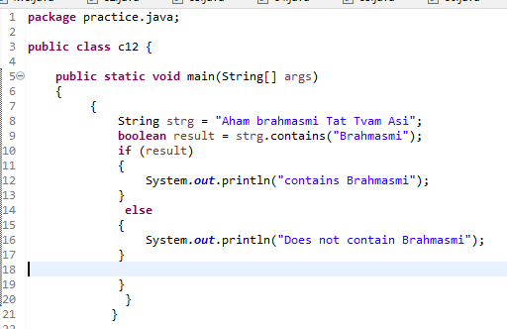
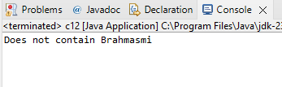
Output
Code

Slide 12
String Trim
In Java, the trim() method is used to remove leading and trailing whitespace characters from a string. This is particularly useful when you're processing user input or reading data from external sources where extra spaces might be unintentionally included.
String trimmedString = string.trim(); is the syntax.
The method does not modify the original string because strings in Java are immutable. It returns a new string with the leading and trailing spaces removed.
Left Trim
In Java, there is no built-in method specifically called "left trim" in the String class, but you can achieve this functionality using other methods. Left trim refers to removing the leading whitespace characters (spaces, tabs, etc.) from the beginning of a string, while leaving the trailing characters intact.
Right Trim
In Java, there is no built-in method specifically called "right trim" in the String class, but you can achieve this functionality using various methods. Right trim refers to removing trailing whitespace characters (spaces, tabs, etc.) from the end of a string, while leaving the leading characters intact.

Slide 13
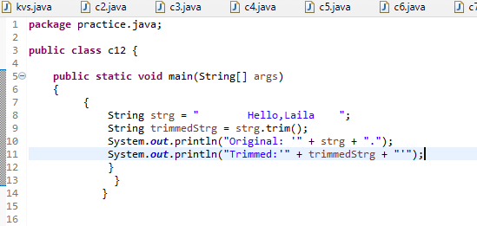
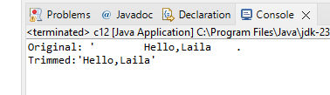
Output 1
Code 1

Slide 14
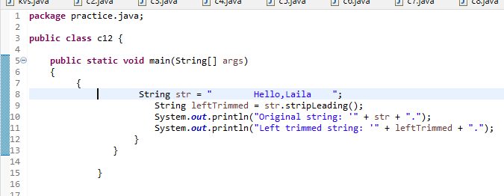
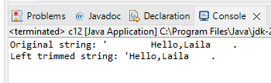
Output
Code 2

Slide 15
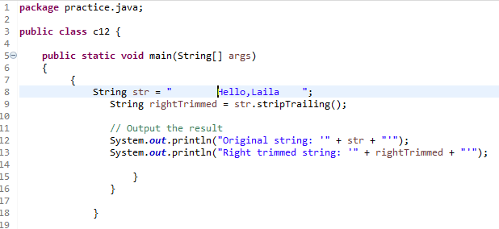
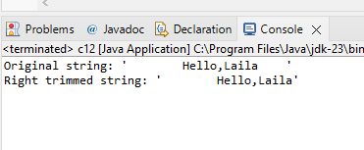
Output
Code 3

Slide 16


